Slide 1
PROTOTYPE Pattern
There are many situations in our applications where we want to take an object's copy from the context and then proceed with this copy with some independent set of operations. Prototype pattern is specifically useful in such scenarios where we can simply copy an object from the current application context and then proceed with it independent of the original object.
Specify the kind of objects to create using a prototypical instance, and create new objects by copying this prototype

Slide 2
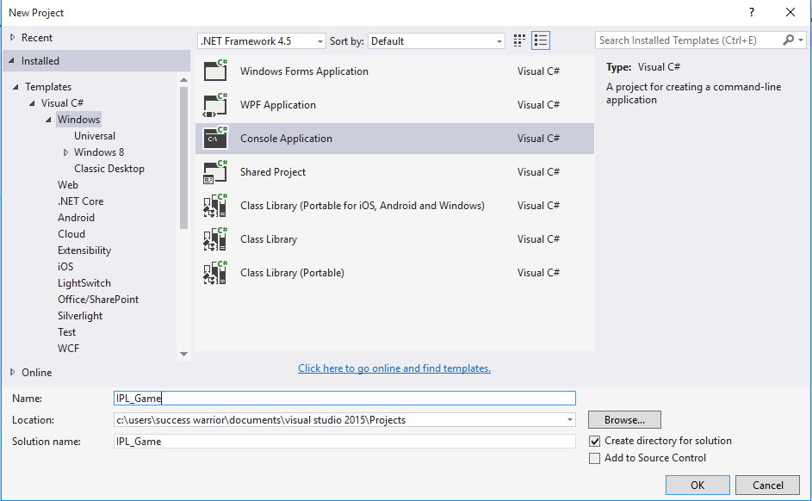

Slide 3


Slide 4
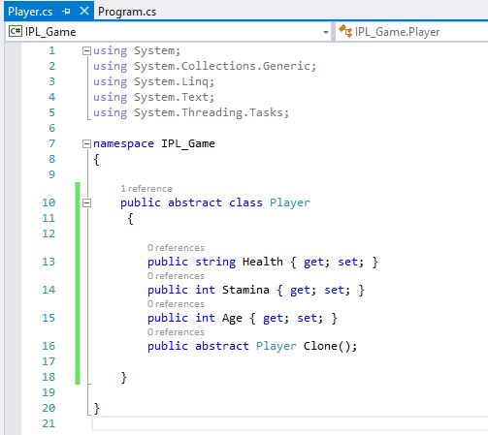
This interface defines all the information required for the player and a clone method so that the object can be cloned.
Now lets say we need a concrete player name sachin in the game. This player should be Cloneable so that whenever we need to save the game we can simply clone the object and initiate the serialization process asynchronously.

Slide 5
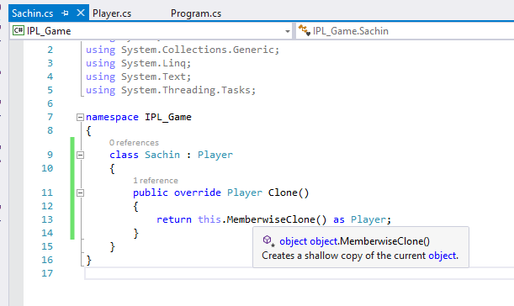

Slide 6
Now this class is the ConcretePrototype that provides the facility to clone itself.
In this example the ConcretePrototype does not contain any specialized members of its own but in some cases this class could contain some member variable or functions of its own

Slide 7
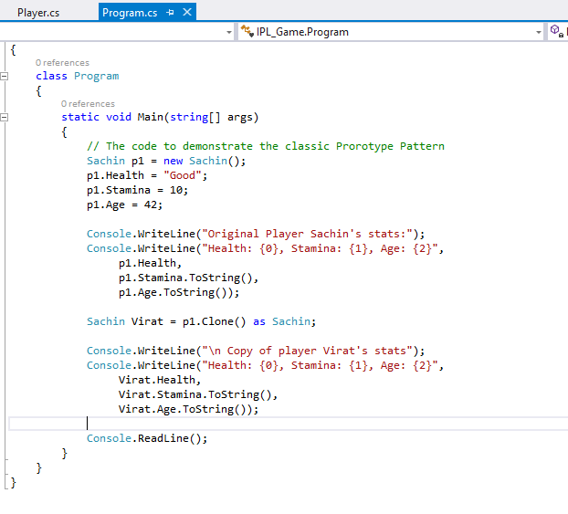

Slide 8
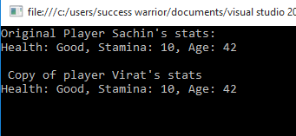

Slide 9
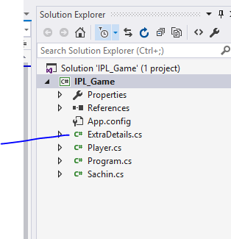

Slide 10
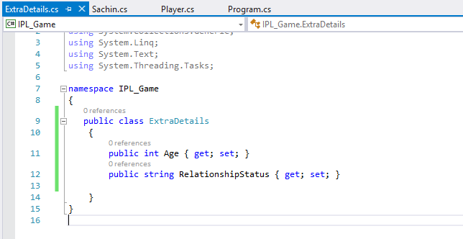

Slide 11
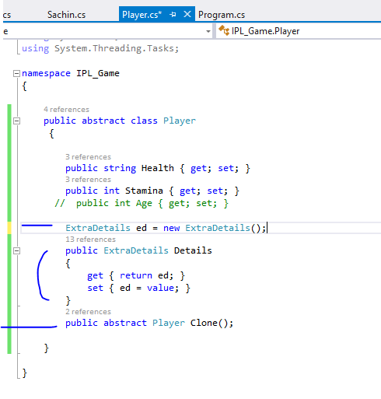

Slide 12
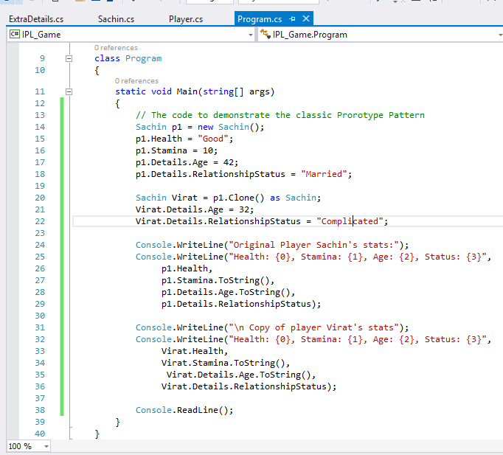

Slide 13
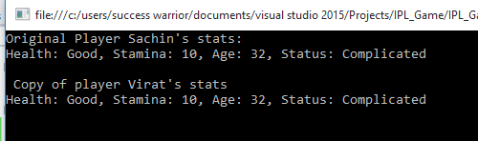
We are using the method MemberwiseCopy in our implementation. The problem with the memberwise copy is that it creates a shallow copy of the object i.e. if the object contains any reference types then only the address of that reference type will be copied from source to target and both the versions will keep pointing to the same object.

Slide 14
To avoid this what we need to do is to create a copy of the internal reference type on the heap and then assign that new object with the copy being returned.
Which is known as deep copy

Slide 15
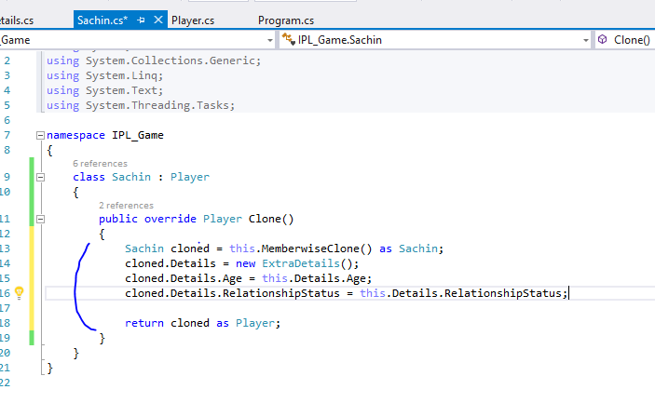

Slide 16
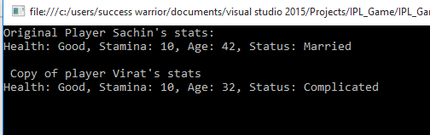

Slide 17
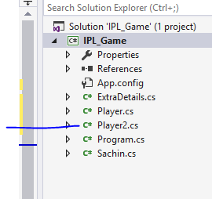
There is one another way
also to clone object

Slide 18
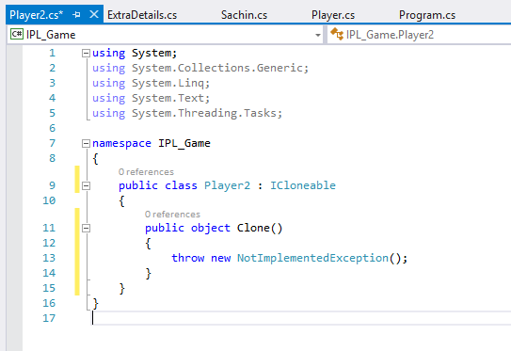

Slide 19
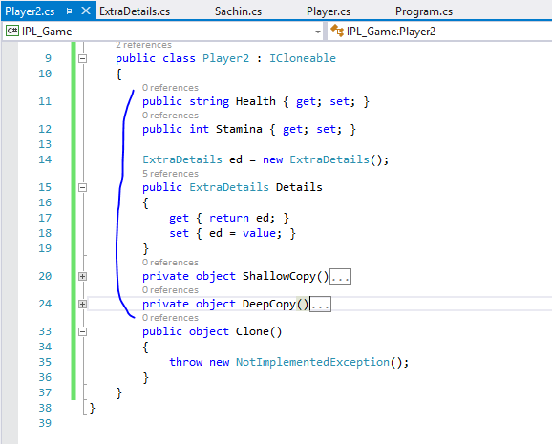

Slide 20
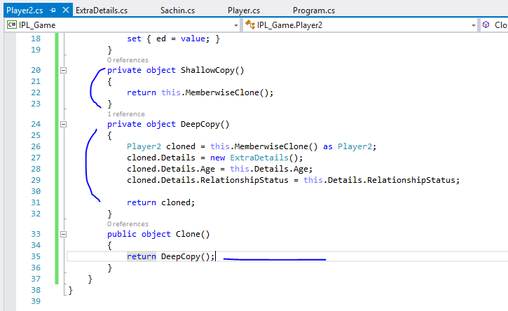

Slide 21
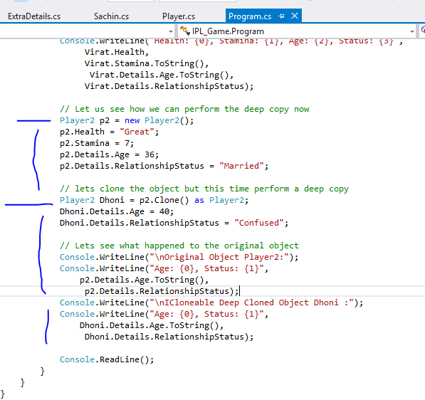

Slide 22
